Slide 1

Two Reasons Why Anyone Would Like To Wipe Out a Particular Memory
Koray Can Yurtseven
ENG211- Section 47

Slide 2
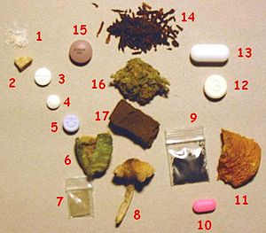
Substance Use Disorder (SUD)
Psychoactive drugs

Slide 3

Post Traumatic Stress Disorder
Sexual assault
Warfare
Traffic collisions
Violent crimes

Slide 4
Thank You

